Slide 1
Software security and vulnerability
Vulnerability and types
Starting point for ensuring security
Security concept
Countermeasures and more vulnerabilities
Security in software development life cycle
Software infrastructure
Sources of software vulnerabilities

Slide 2
What is a Vulnerability?
A vulnerability is a weakness that can be exploited by cybercriminals to gain unauthorized access to a computer system.
After exploiting a vulnerability, a cyber-attack can run malicious code, install malware, and even steal sensitive data.
Vulnerabilities can be exploited by a variety of methods, including
- SQL injection,
- buffer overflows,
- cross-site scripting (works by manipulating a vulnerable web site so that it returns malicious JavaScript to users)
- etc.

Slide 3
Examples of vulnerabilities
These are some examples of vulnerability:
A weakness in a firewall that can lead to malicious hackers getting into a computer network
Lack of security cameras
Unlocked doors at businesses
All of these are weaknesses that can be used by others to hurt a business or its assets.

Slide 4
Vulnerability classification

Slide 5
Vulnerability classification
Vulnerabilities can be classified into six broad categories:
1. Hardware
Any susceptibility to humidity, dust, soiling, natural disaster, poor encryption, or firmware vulnerability.
2. Software
‍Insufficient testing, lack of audit trail, design flaws, memory safety violations (buffer overflows, over-reads, dangling pointers), input validation errors (code injection, cross-site scripting (XSS)) etc.

Slide 6
Vulnerability …………
3. Network
Unprotected communication lines, man-in-the-middle attacks, insecure network architecture, lack of authentication, default authentication, or other poor network security.
4. Personnel
Poor recruiting policy, lack of security awareness and training, poor adherence to security training, poor password management, or downloading malware via email attachments.

Slide 7
Vulnerability …………
5. Physical
Area subject to natural disaster, unreliable power source, or no keycard access. A physical vulnerability may include:
The ability to access server rooms
Camera blind spots
Inadequate documentation
Recording of physical activities performed in the data center, such as replacing storage devices
6. Organizational
Improper internal controls, lack of audit, continuity plan, security, or incident response plan.

Slide 8
Starting Point for Ensuring Security

Slide 9
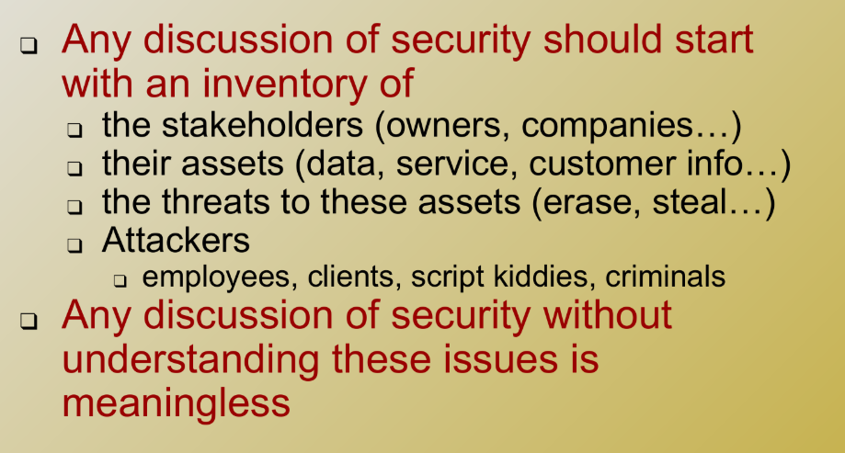
Starting Point for Ensuring Security

Slide 10
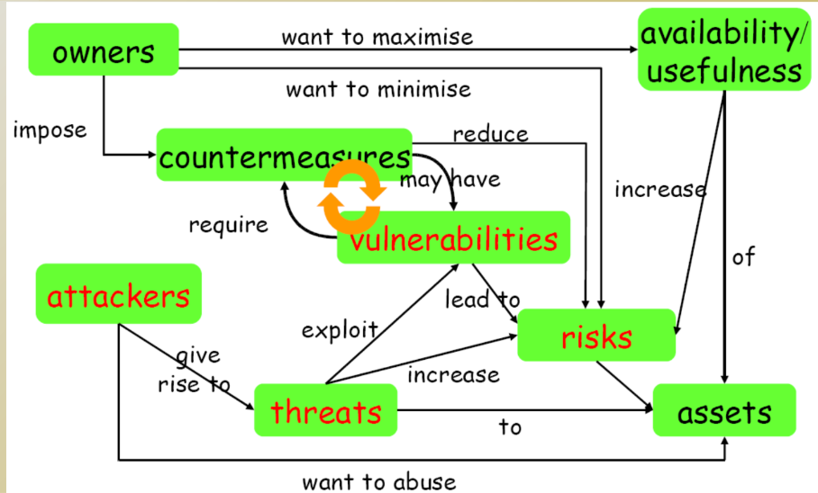
Security Concept

Slide 11
Countermeasures
Countermeasures can be non-IT related
Physical security of building
Screening of personnel
Legal framework to deter criminals
Training employee

Slide 12
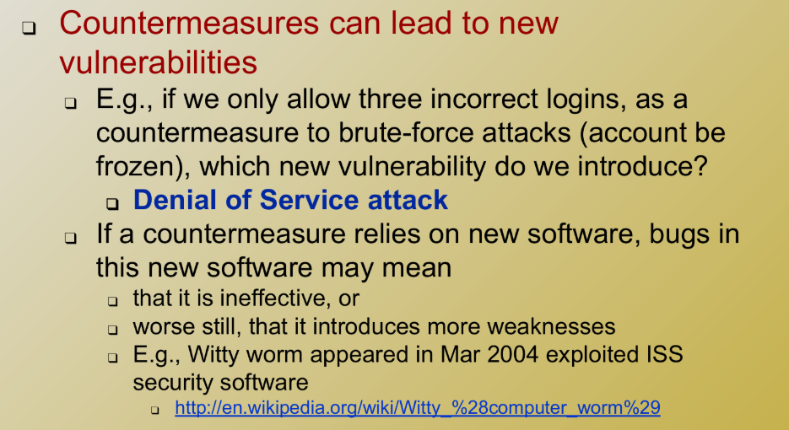
Countermeasures and More Vulnerabilities

Slide 13
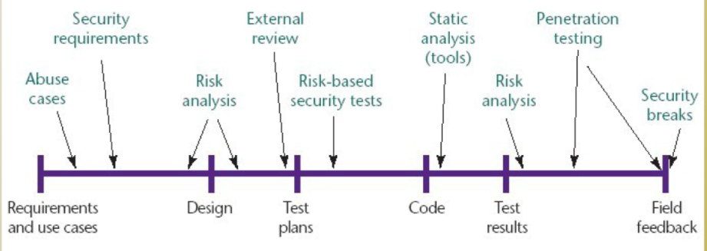
Security in Software Development Life Cycle

Slide 14
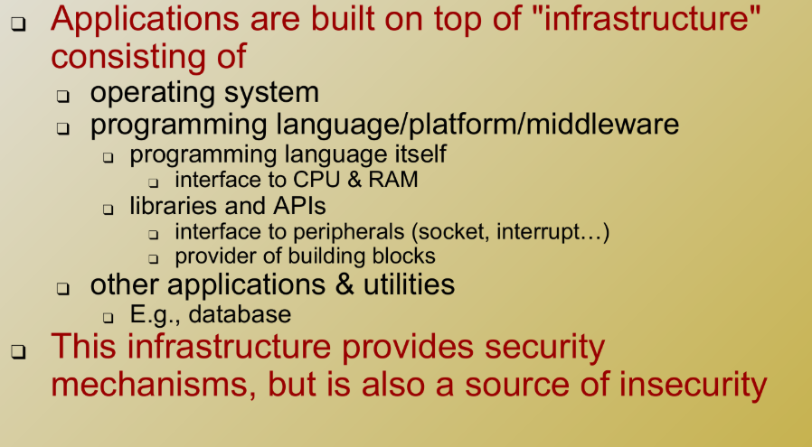
Software Infrastructure

Slide 15
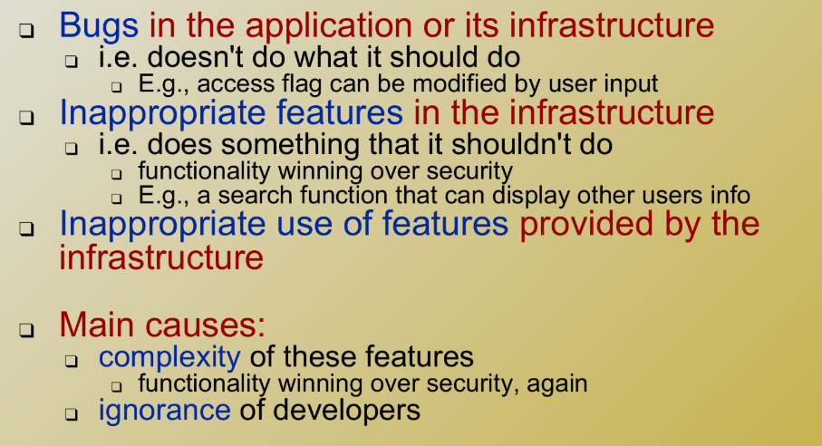
Sources of Software Vulnerabilities

